Slide 1
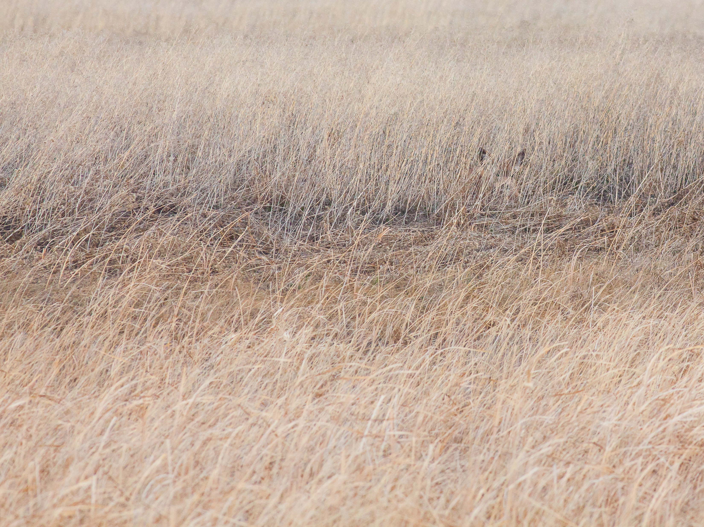
Livestock grazing effects on Western terrestrial vertebrates: a systematic review and meta-analysis
Daniel C. Barton, W. Tim Bean, Abigail Rutrough
Supporting Authors: Cara Appel, Emily Buck, Kelly Commons, Matthew Delgado, Justin Demianew, Sharon Dulava, Melica Dunne, Aaron Gottesman, Alyssa Marquez, and Nora Papian
Humboldt State University, Arcata, CA 95521

Slide 2
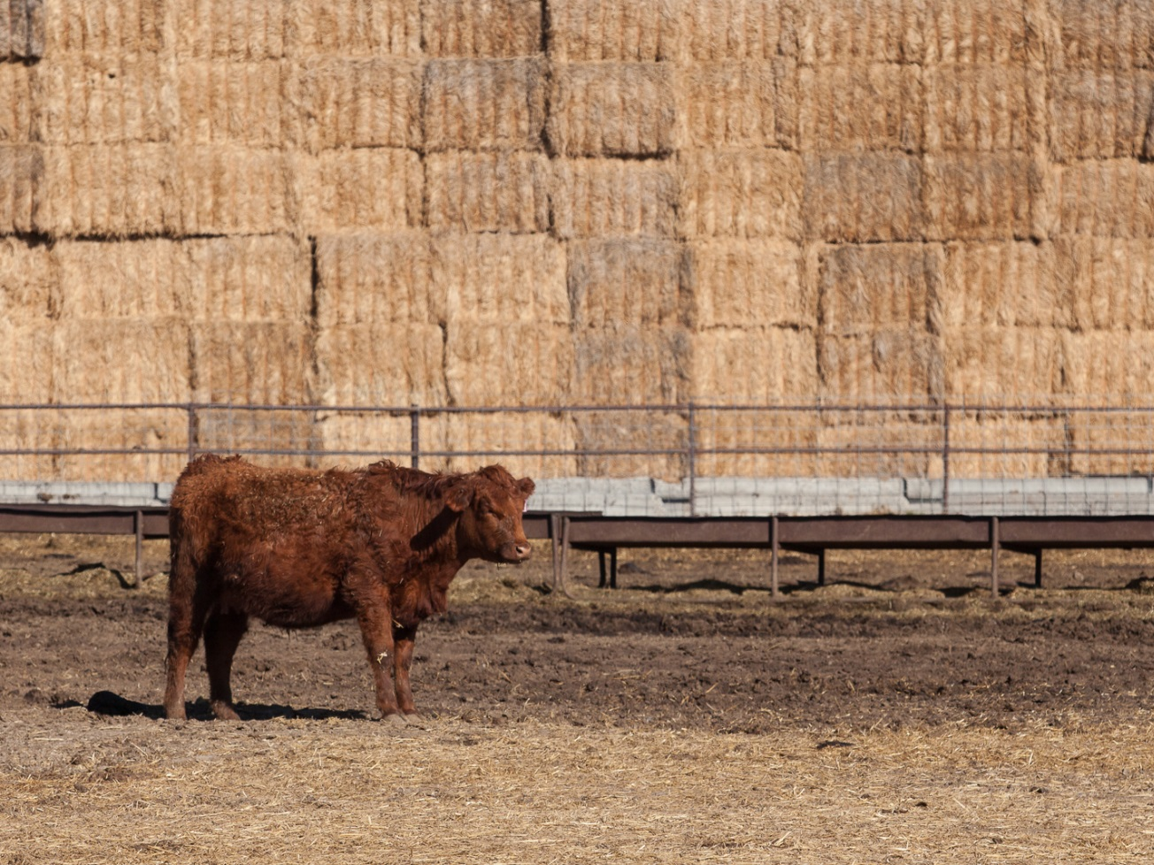
Motivation: livestock grazing and wildlife

Slide 3
Motivation: livestock grazing and wildlife
Discussions of the effects of livestock grazing can have a substantial emotional component
Livestock grazing is the predominant use of the world’s land masses, including many protected areas
Qualitative scientific reviews and opinion pieces abound, yet few systematic reviews and quantitative syntheses are available
Heterogeneity of livestock impacts on vertebrate wildlife often seems to defy generalization

Slide 4
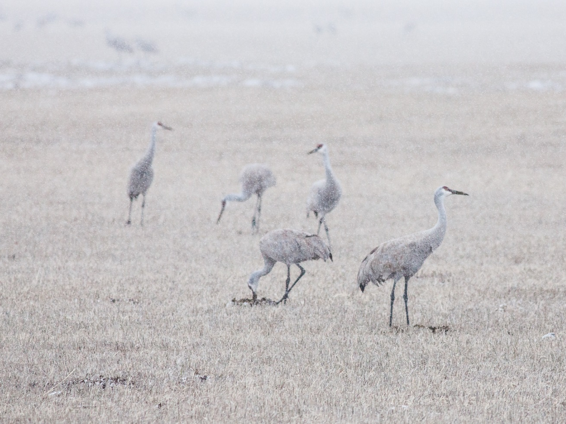
Design challenges in livestock impact studies

Slide 5
Design challenges in livestock impact studies
Design constraints: lack of suitable reference/control sites
Confounding temporal effects in before-after studies
Confounding spatial effects in treatment-control studies
Access or funding constraints cause poor within-study replication
Spatial and temporal heterogeneity of grazing practices results in treatment heterogeneity
Heterogeneity of community-level and population-level response

Slide 6


Meta-analysis
Scope: studies of vertebrate wildlife abundance, diversity, and demographic response to livestock grazing from treatment-control or before-impact designs
Quantitative approach to combining results of studies
Generalization of measure of effect sizes overall or by group
Exploration of the influence of moderators on effect size
Identification of issues with available data
Open Science Framework – transparency & repeatability
Preferred Reporting Items for Systematic Reviews and Meta-Analyses (PRISMA) prisma-statement.org
osf.io

Slide 7
Source Review and Inclusion*
Records identified during initial database search and filter process: 110, Kappa = 0.63-0.97
Web of Science and Google Scholar searches, example term: (graz* AND effect*) AND abundance*
1012 references
Additional records identified by forward & backwards citation search of initial records:
171 + 110 = 281
Excluded - no control comparison, opinion paper, never subjected to review, insufficient data, confounded treatment effect: 186 + 14 unavailable
Records identified for data extraction:
81 with 81 complete
Abundance Data: 38/298
Complete Richness Data: 14/34
Complete Abundance Data: 27/255
*Modified PRISMA Flowchart

Slide 8
Measure of Effect Size & Moderators
Effect size
Hedges’ d*
Measures effect size as mean difference in units of standard deviation
Treatment (grazed) – control (ungrazed)
Requires variance and n
Moderators
Fixed effects:
Riparian/Upland
Taxonomic class
Study design
Grazing treatment
Random effects:
Study ID
Study year
Calculations and parameter estimation conducted with library metafor, graphing with library ggplot2 in R
*sensu Nakagawa and Cuthill 2007, Biol. Rev.

Slide 9
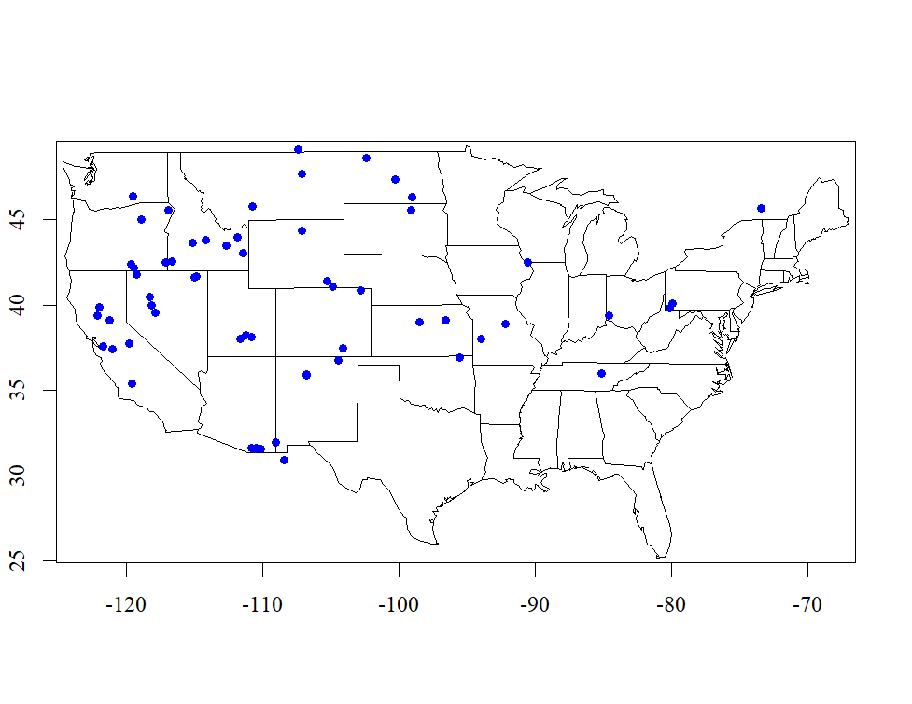
Map of studies with extracted data
“West”

Slide 10
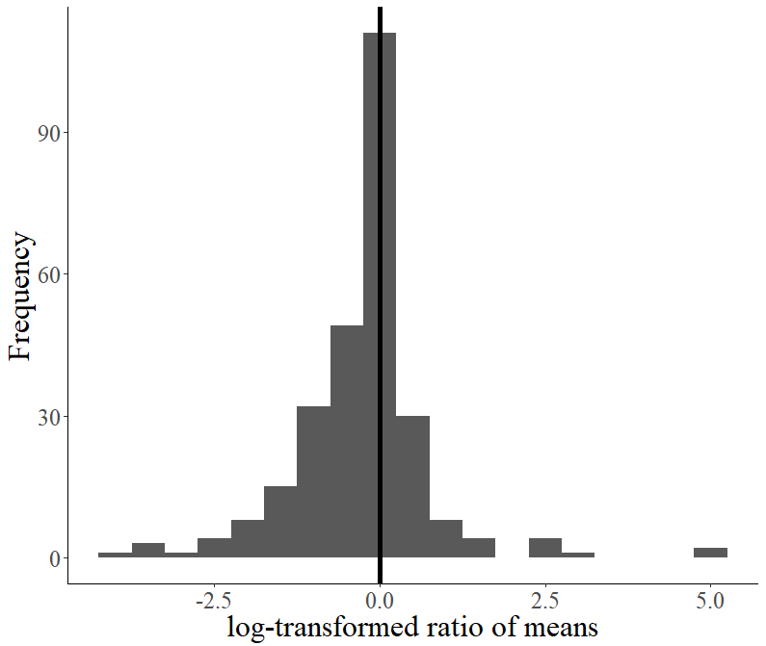
Abundance: Effect Size – All Studies
38 studies
298 effect size estimates
1-48 per study

Slide 11
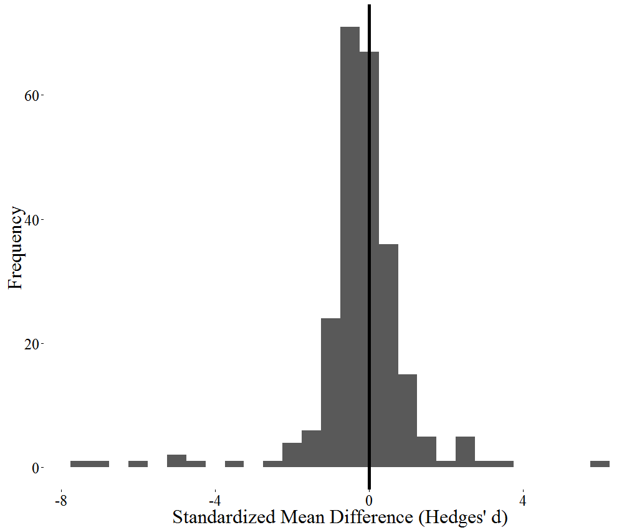
Abundance: Effect Size – Complete Studies
27 complete studies
255 effect size estimates
1-48 per study

Slide 12
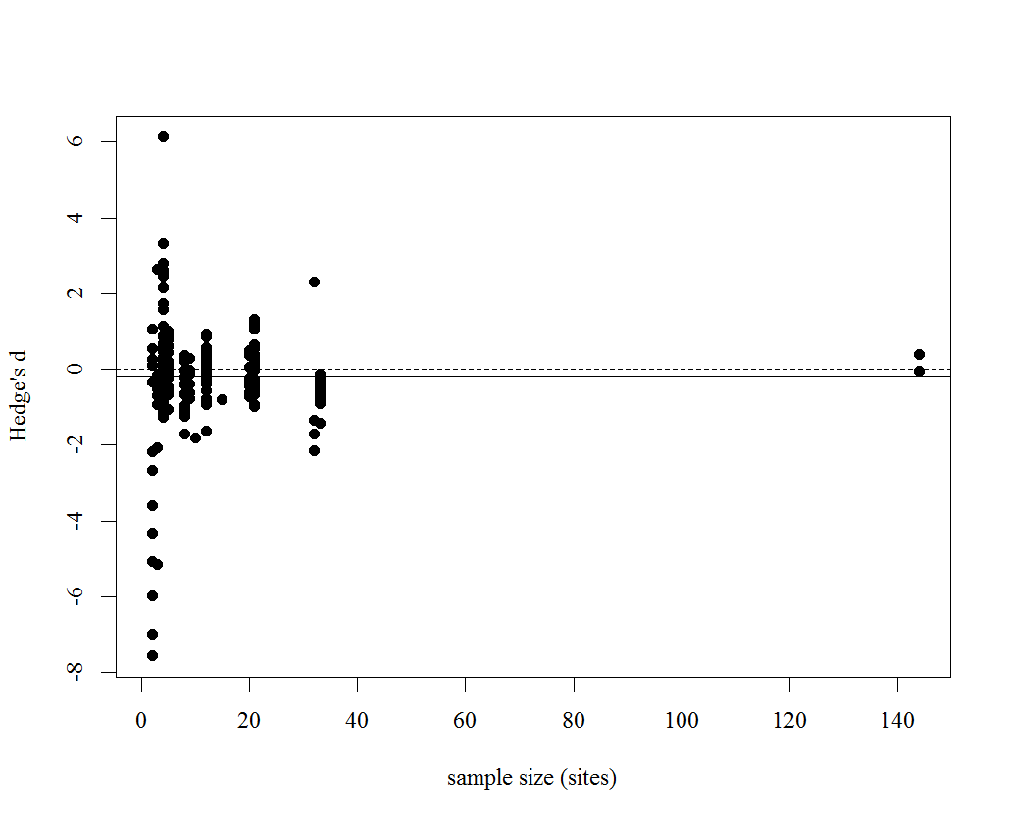
Abundance: Effect Size & Sample Size
Average Effect Size: -0.1892
Rosenberg’s fail-safe N*: 3281
*number of additional un-included studies with a mean effect size of 0 required to negate observed effect size
Studies with few spatial replicates show variable effect sizes

Slide 13
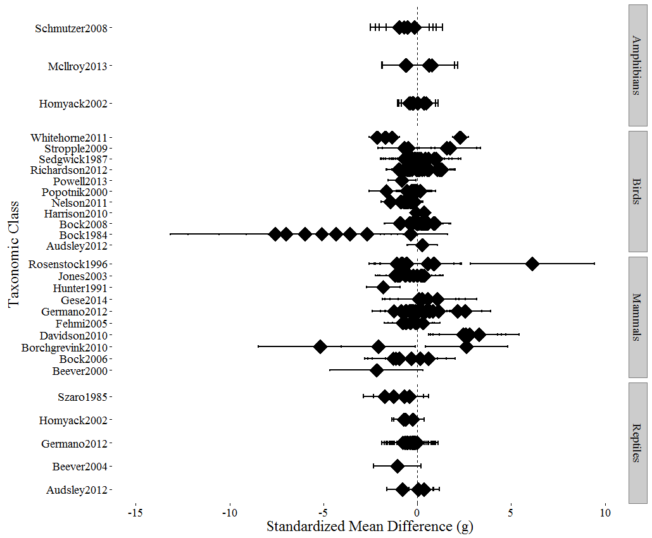
Abundance: Forest Plot by Class
95% CI
multiple
effect sizes within study
Cochran’s Q
Q_{E} = 846, 241 df
Q_{M} = 17.2, 4 df

Slide 14
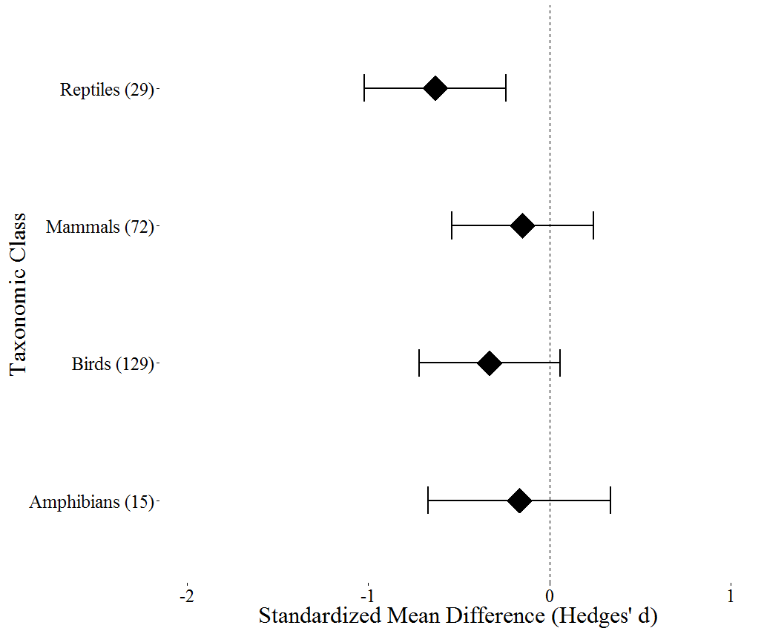
Abundance: RE Model Effect Size Estimates
95% CI

Slide 15
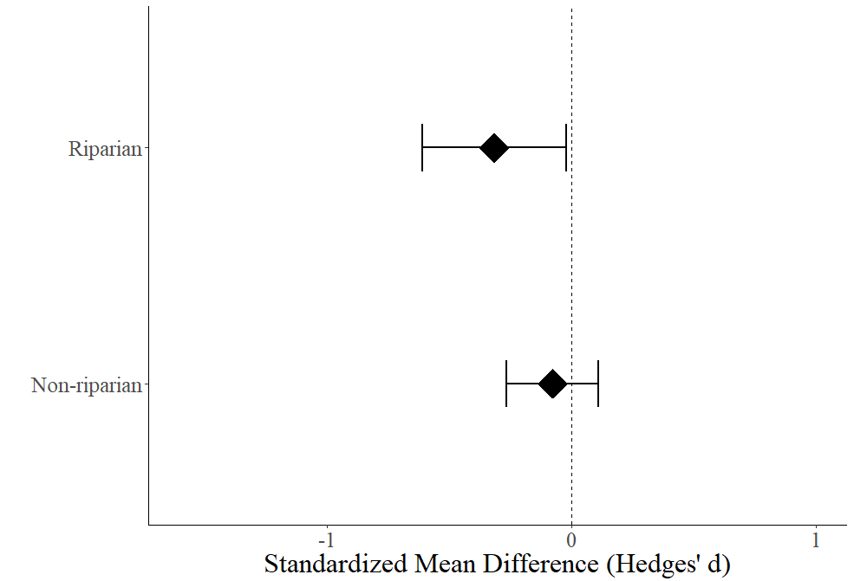

Abundance Study Design Moderators
n = 65
Similar preliminary results for moderators:
study type (randomized)
plant community type
grazing intensity is a dumpster fire
n = 178

Slide 16
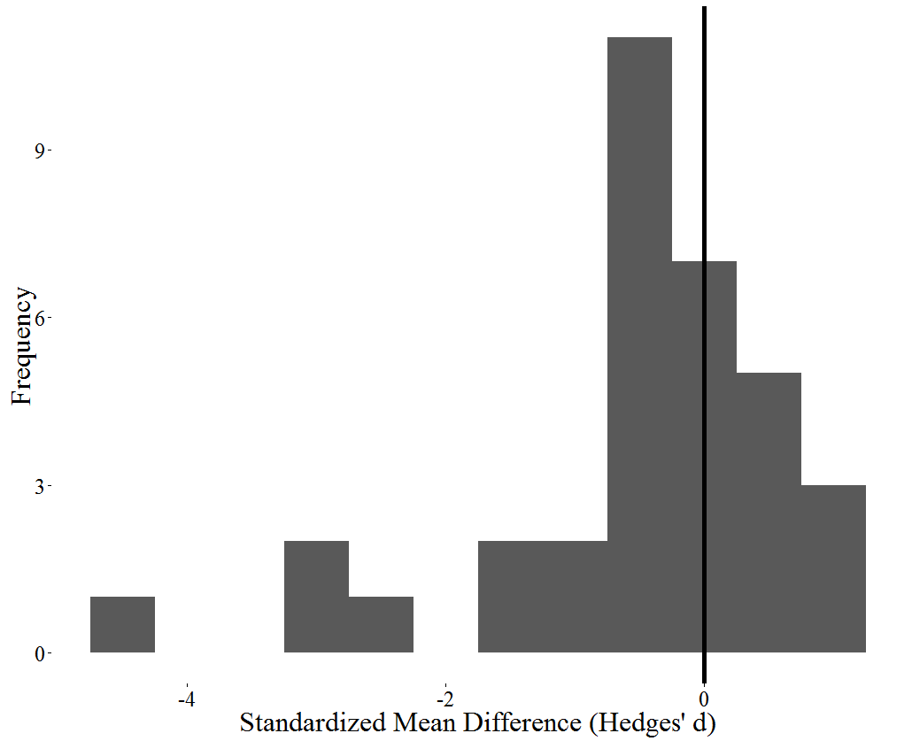
Richness: Effect Size
14 complete studies
34 effect size estimates
1-6 per study

Slide 17
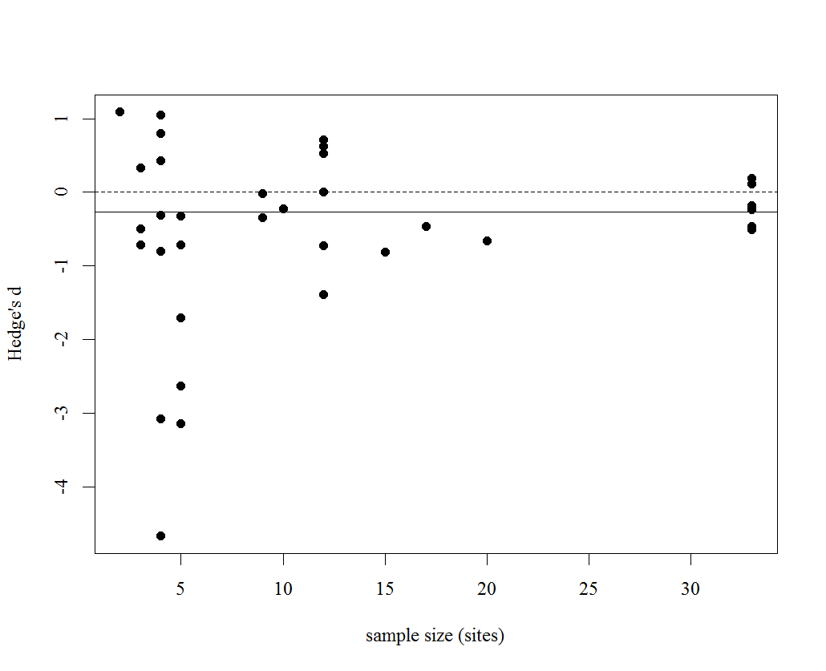
Richness: Effect Size & Sample Size
Average Effect Size: -0.2619
Rosenberg’s fail-safe N*: 99
*number of additional un-included studies with a mean effect size of 0 required to negate observed effect size
Studies with few spatial replicates show variable effect sizes

Slide 18
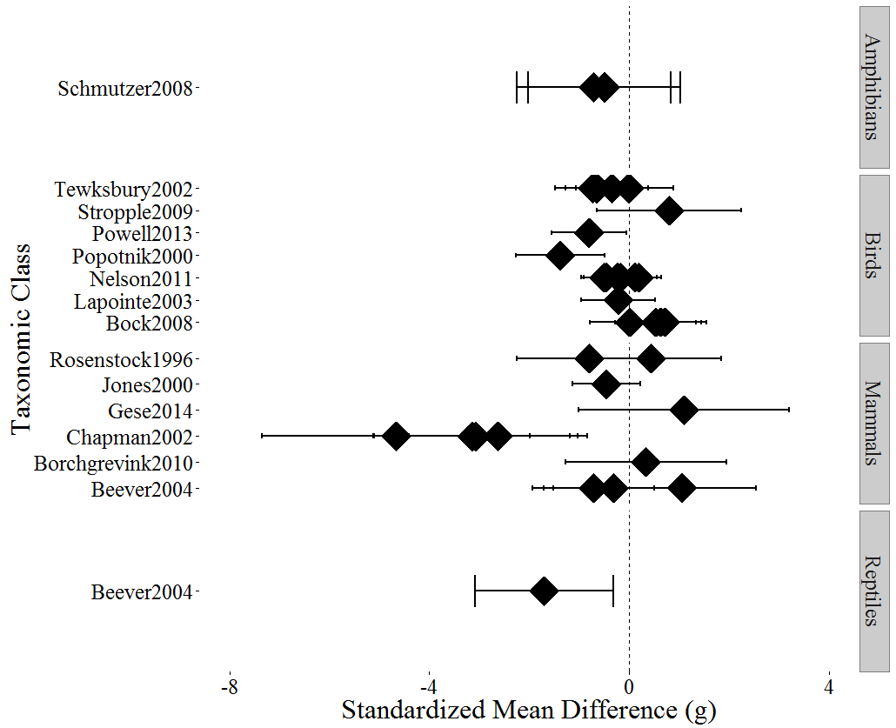
Richness: Forest Plot by Class
95% CI
multiple
effect sizes within study
Cochran’s Q
Q_{E} = 72.2, 30 df
Q_{M} = 7.5, 4 df

Slide 19
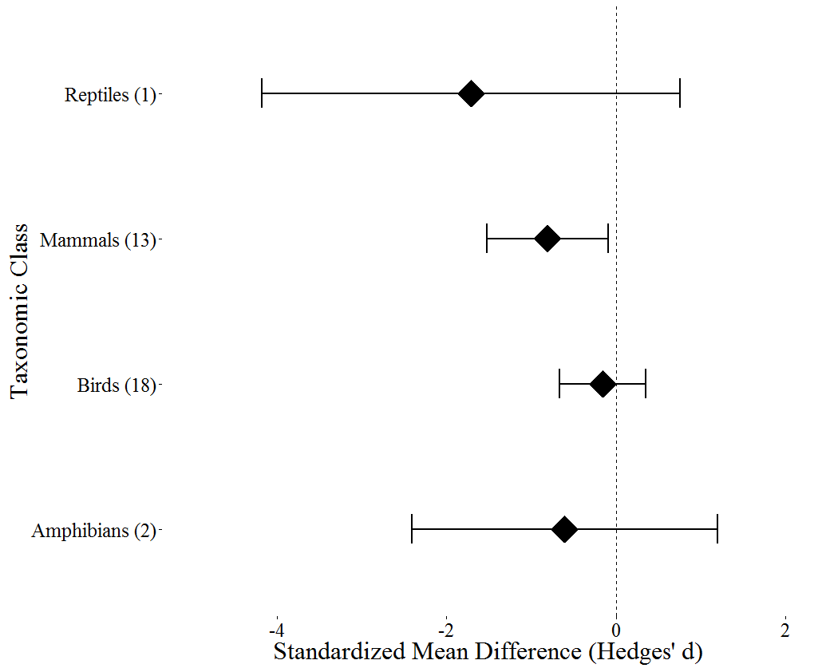
Richness: RE Model Effect Size Estimates
Cochran’s Q
Q_{E} = 72.2, 30 df
Q_{M} = 7.5, 4 df

Slide 20
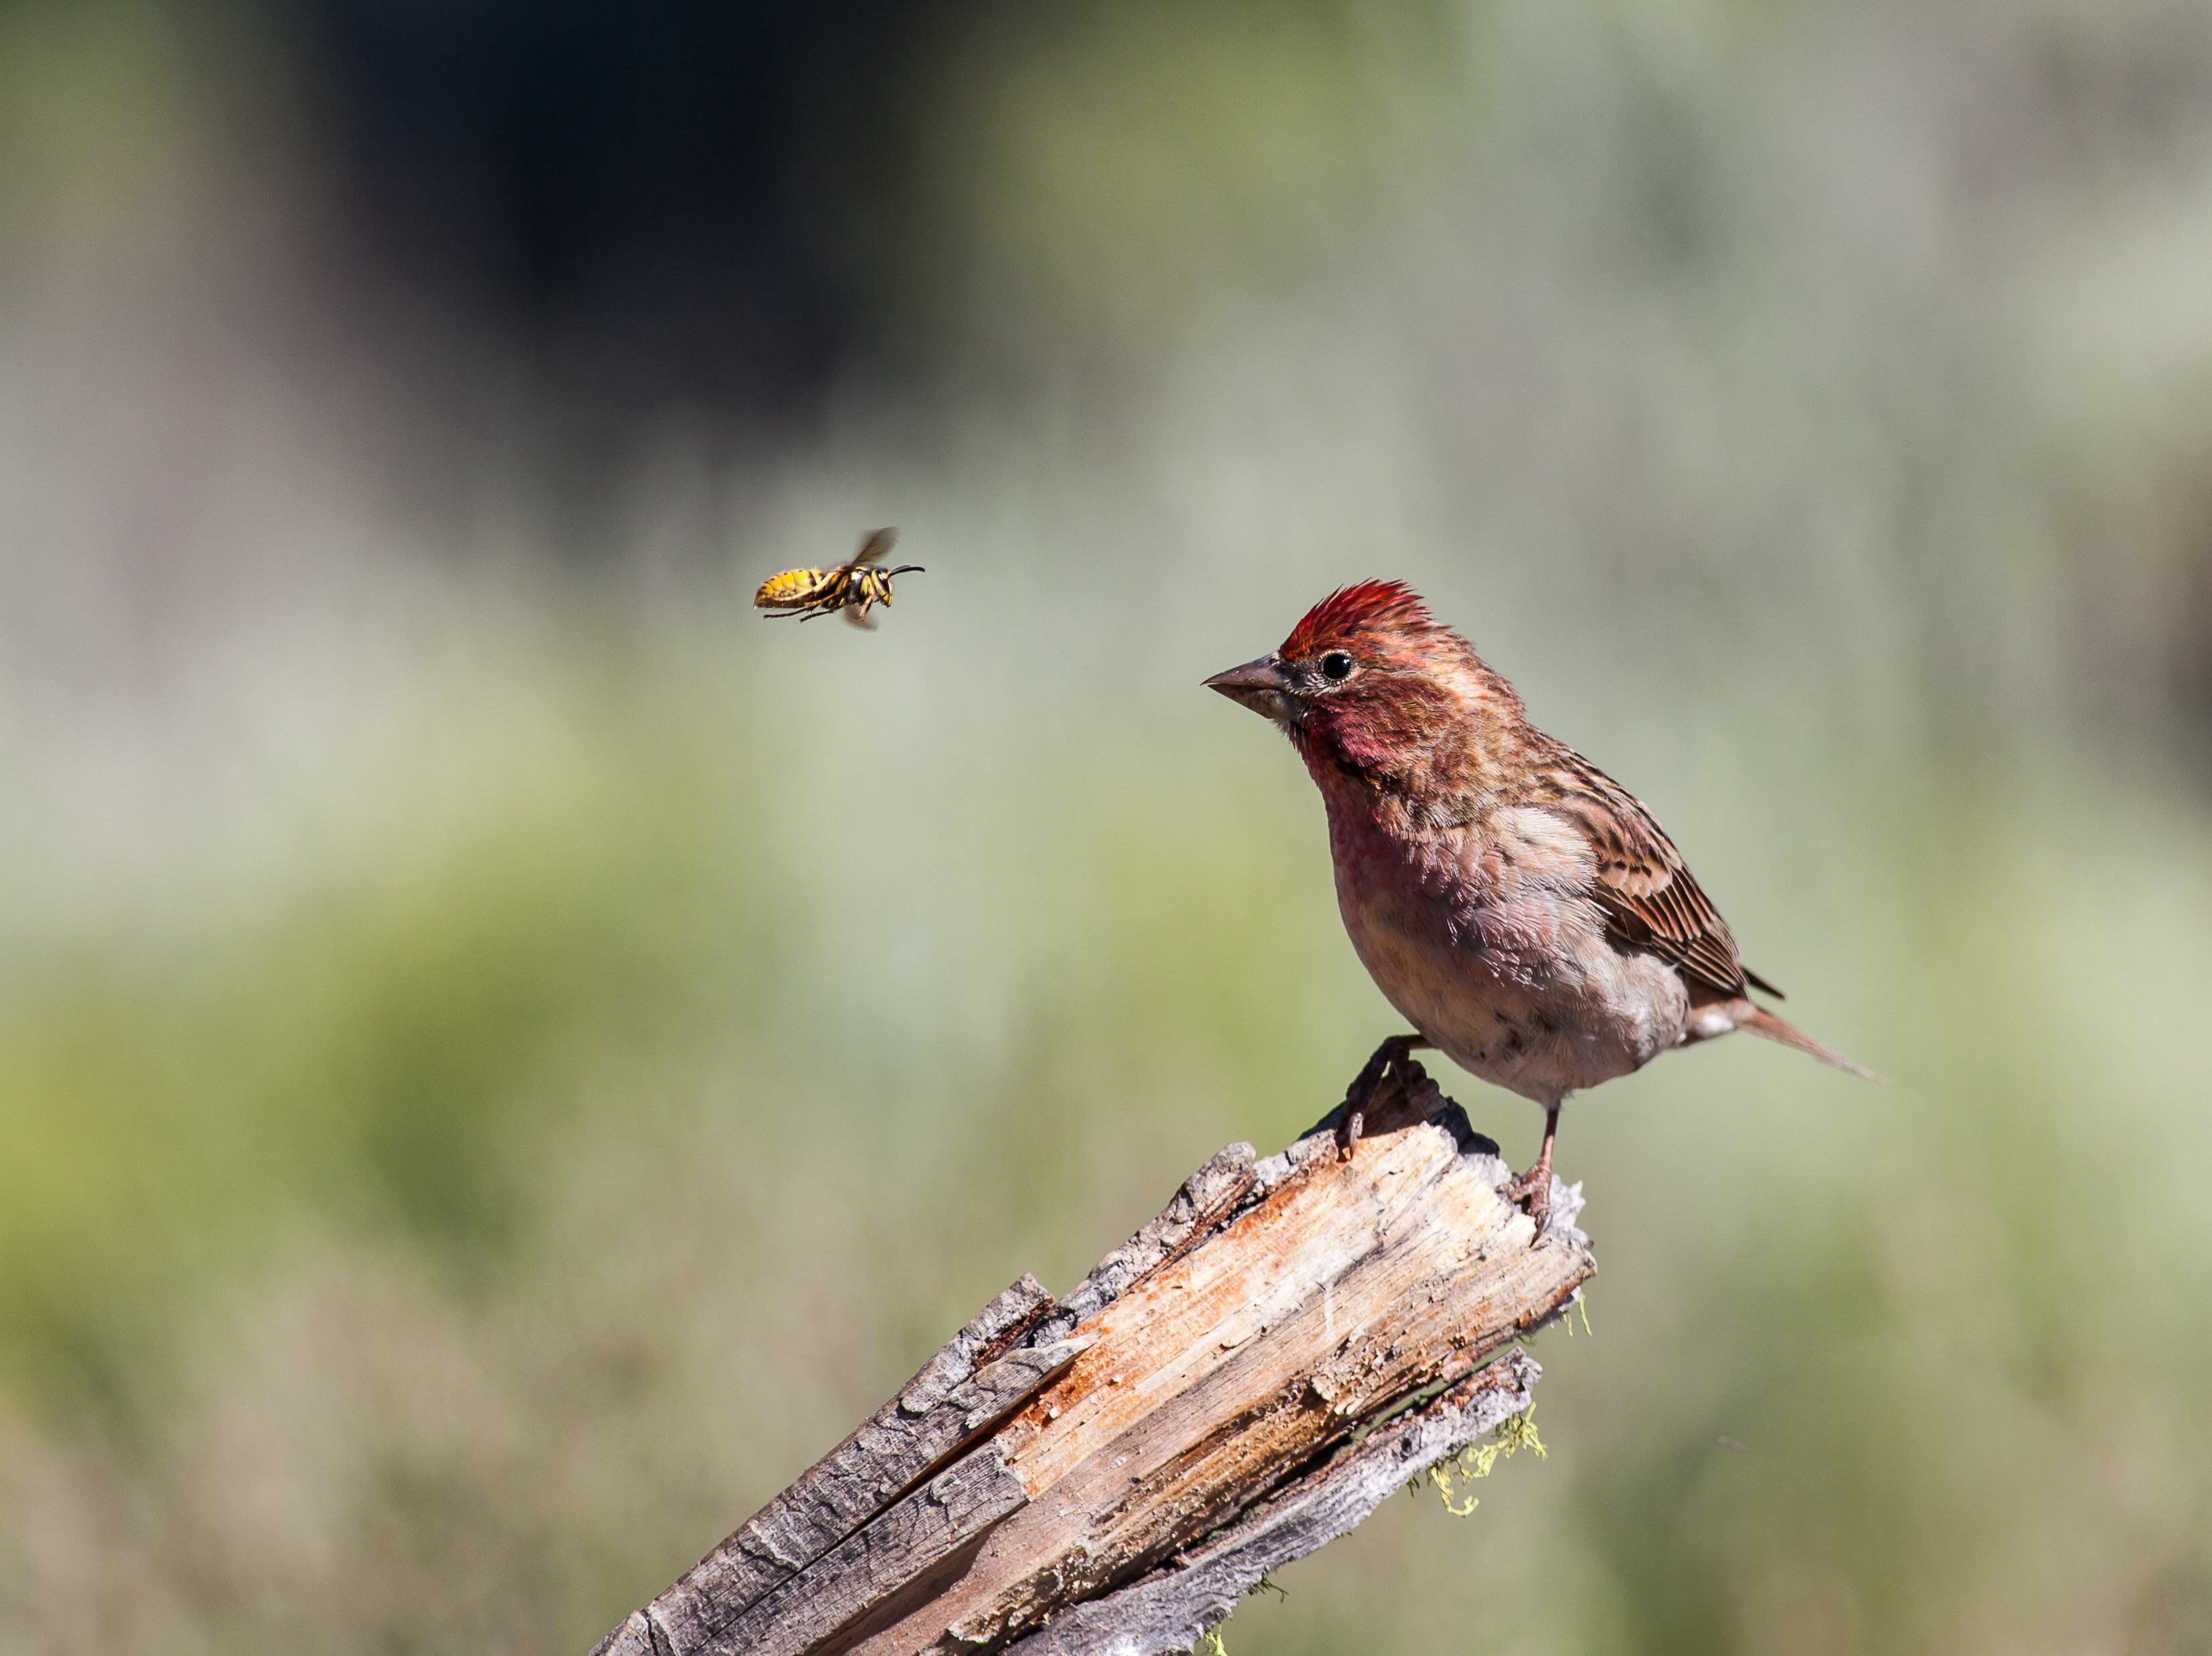
To-do list

Slide 21
To-do list
Provide access to osf.io project to volunteer expert reviewers (i.e. you?)
Additional exploration of moderators, especially climate (PRISM) and regime (difficult)
Author contact or multiple imputation for studies with partially missing data
Random-effects phylogenetic meta-analysis with nested and crossed effects with missing data and unbalanced design that still yields defensible variance estimates (note: I’m not doing this, but you should)

Slide 22
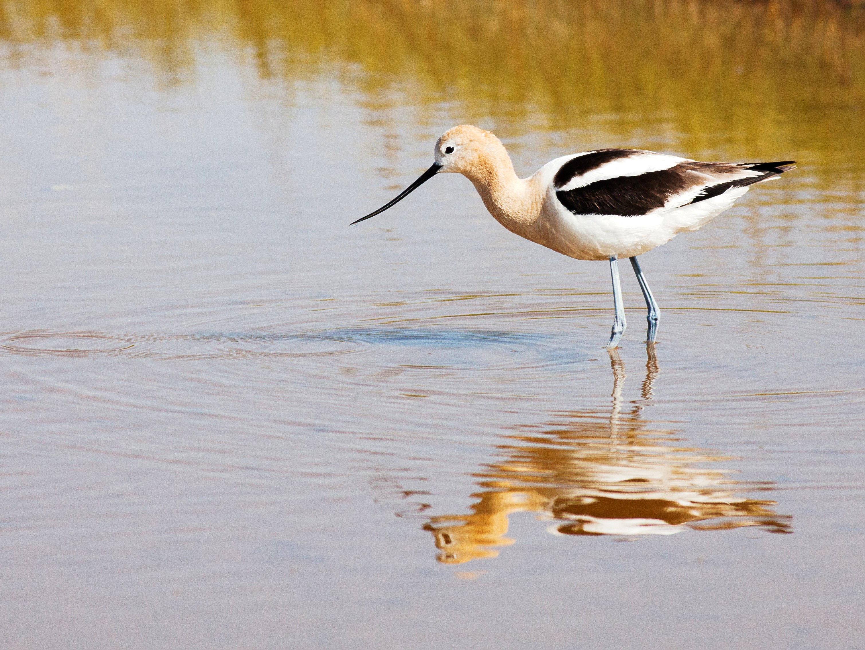
Acknowledgements
Authors of studies whose data we pilfered
HSU College of Natural Resources and Sciences

